Slide 1


Acentra Health Care | ClaimShield Nexus
Multi-Layered Fraud, Waste, and Abuse (FWA) Detection Engine & SIU Investigator Workspace
Sneha D H (Team Leader)
Shabuir Shahin A
Shalini D

Slide 2
The Proposed Solution
Executive Summary
  Tri-Factor Composite Risk Scoring: Replaces isolated alerts by combining Business Rules (30%), Machine Learning (30%), and Network Graph Centrality (40%) into a single prioritized score.
  Forward Loss Exposure Forecasting: Calculates daily provider billing velocity to project cumulative 90-day financial loss horizons.
  AI Copilot & Second Brain Workspace: Sub-100ms context aggregation, policy RAG citations, refusal guardrails, and auto-compiling provider wiki summaries.
The Problem
  Massive Financial Loss: Healthcare FWA costs insurance providers billions annually due to undetected billing anomalies.
  Legacy System Deficiencies: Rigid rule engines miss complex fraud schemes, while standalone ML models operate as unexplainable "black boxes".
  Investigator Fatigue & Memory Loss: SIU teams face severe alert fatigue from isolated alerts and lack persistent memory tools across cases

Slide 3
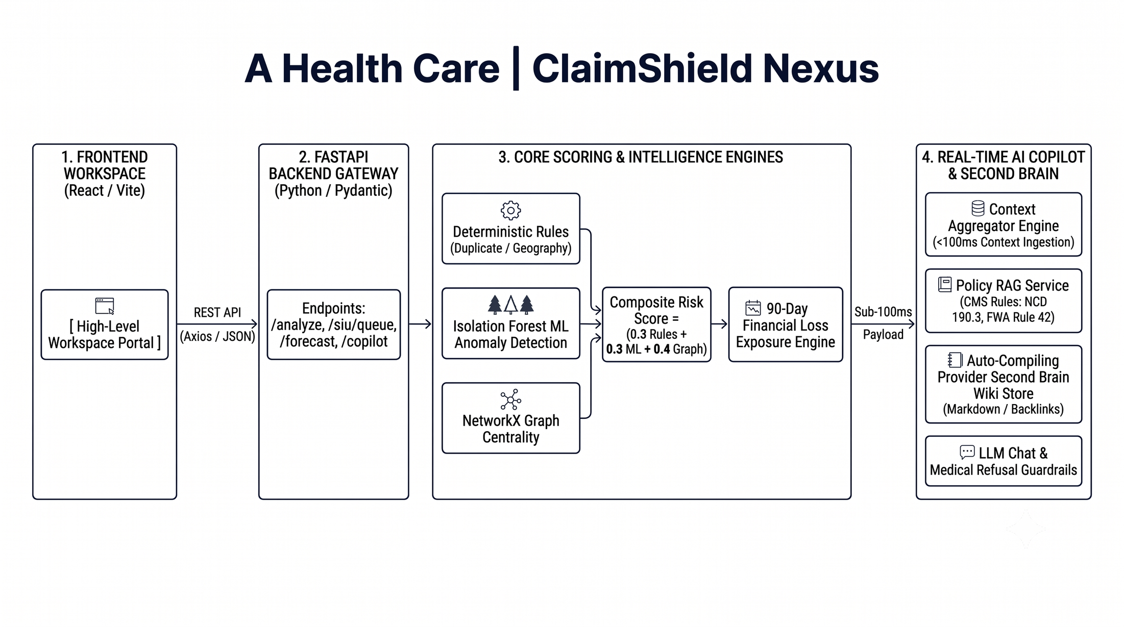
A Health Care | ClaimShield Nexus

Slide 4

Synthetic Data & Fraud Injection
NetworkX Graph Analytics
  Zero-HIPAA Data Generator: Generated 5,000+ synthetic claims, 200 provider NPIs, 1,000 members, and 50 facilities via Faker with zero missing primary keys (test_data_gen.py).
  Hardcoded Synthetic Fraud Patterns:
  Phantom Billing: Dr. Synthetic-A billing for non-existent patients.
  Upcoding Spikes: CPT code manipulation driving billing 4 times above peer baselines.
  Impossible Geography: Dr. Synthetic-B submitting claims in Chennai and Delhi within 2 hours.
  Handoff Output: Exported claims.json and claims.csv to Backend and Copilot services.
  Relationship Mapping: Nodes = Providers, Members, Clinics; Edges = Claims, Referrals, Shared Tax IDs.
  Coordinated Fraud Ring Analytics: Connected component and centrality algorithms identifying high-density billing loops.
  Graph Handoff: Exported centrality scores (>0.75) to Composite Scoring Engine and GET /api/v1/graph/{case_id} to React Flow UI.

Slide 5
FastAPI Core Gateway
Dual Detection Engine
  Rules Engine (rules_engine.py): Checks duplicate billing (<5 mins), impossible geography (<2hrs ), and upcoding spikes (>= 4* benchmark).
  ML Anomaly Engine (ml_engine.py): Isolation Forest model trained on claim vectors, outputting a normalized anomaly score (0.0 - 1.0).
  Configured a modular zero-cost Python backend architecture with rigid Pydantic schemas (Claim, Provider, SIUCase, GraphPayload).
  Verified API endpoints respond with HTTP 200 in sub-20 ms base execution time.
Master Composite SIU Case Ranking
  Master Composite SIU Case Ranking Matrix (app/services/siu_ranking.py)
  Master Formula:
  Composite Risk Score = (0.4 * Rules) + (0.4 * ML Anomaly) + (0.2 * Graph Centrality)
  Ranks SIU cases dynamically to eliminate alert fatigue and surface highest-exposure cases at the top.

Slide 6
Financial Loss Exposure Forecasting & Context Aggregator
  90-Day Loss Exposure Forecasting (app/services/forecasting.py)
  Daily Billing Velocity Math: Calculates a provider's historical billing velocity (billing rate/day) rather than relying on static historical totals.
  Cumulative Exposure Horizons: Dynamically projects monetary loss over 90 days if a flagged provider remains unaddressed.
  Actionable ROI: Enables SIU leadership to prioritize investigations based on projected dollar impact
  Sub-100ms Real-Time Context Aggregator (app/services/context_aggregator.py)
  Unified Context Payload: Combines claim records, rule flags, ML scores, graph centrality, loss forecasts, and policy snippets into a single JSON payload.
  Performance Benchmark: Assembles and delivers full case context in <100 ms (test_phase3.py), ensuring zero lag during real-time LLM prompt streaming

Slide 7
Policy Knowledge Base, Auto-Compiling Provider Wiki & Guardrails
Regulatory Policy RAG (app/services/policy_rag.py)
  Vector similarity retriever matching CMS policy documents (NCD 190.3, FWA Rule 42) directly to flagged claims.
Auto-Compiling Provider Second Brain Wiki (/data/wiki/providers/)
  Automatically compiles/updates Markdown summaries (NPI_{id}.md) upon investigator action (APPROVE, PAUSE_PAYMENT, REFER_TO_SIU).
  Tracks behavioral trends, decision history with AI confidence scores, and entity backlinks ([[fraud_rings/...]]).
Responsible AI Guardrails & Audit Ledger (app/services/guardrails.py)
  Refusal Layer: Safety checks block requests for clinical diagnosis or medical treatment advice while attaching confidence bounds (0-100%).
  Audit Ledger (POST /api/v1/cases/{case_id}/action): Stores investigator notes, timestamps, and decisions in an immutable log (audit_ledger.json).

Slide 8
Quantifiable Business Impact & Future Roadmap
Institutional Memory Retention
  Auto-compiling Provider Wiki Entries build an enduring knowledge base that persists across investigator shifts and team transitions.
Quantifiable Business Impact
  Reduced Alert Fatigue: Tri-factor composite scoring ranks true fraud schemes higher, cutting false positive reviews for legitimate high-volume clinics.
  Sub-100ms Memory Latency: Real-time context aggregation enables instant AI Copilot response during live investigations.
  100% Zero-Cost Open-Source Stack: Built entirely using open-source Python and React tools (FastAPI, Scikit-Learn, NetworkX, Vite) with zero software licensing costs.
  Scaling integration with state Medicaid MMIS platforms (such as Acentra Health evoBrix® X).
  Real-time streaming claim ingestion pipeline and automated payment-hold workflow orchestration.
Future Technical Roadmap
Closing Statement:
Acentra Health Care | ClaimShield Nexus — Empowering SIU Investigators with Explainable AI."

Slide 9
THANK YOU

